Slide 1
ROP 生成系統 ROPchain: ROP payload Generation
An Anti-Mitigation Exploit Generation Integrating with Metasploit Framework
From Hung-Wen Chen (陳泓文)
Lectured by Shih-Kun Huang (黃世昆)
Software Quality Lab
National Chiao Tung University

Slide 2
Outline
Motivation
Objective
Background
Method
Implement
Integration
Result
Conclusion
Further Work
Q & A

Slide 3
Motivation
Automatic Exploit Generation
Bypassing mitigations
Combining with Metasploit Framework

Slide 4
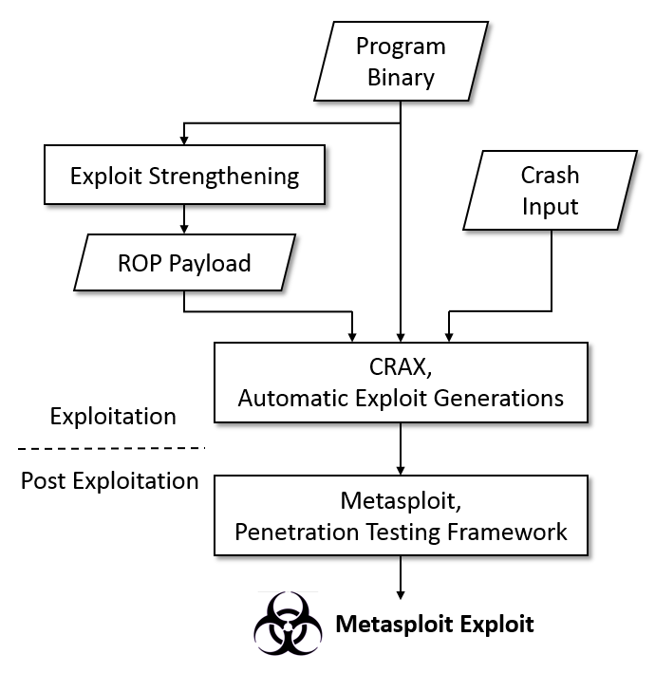
Objective
Exploit Toolchain
Anti-mitigation exploit
Metasploit and Post-exploitation integration

Slide 5
Background
Protection mechanisms
W⊕X、DEP
Address Space Layout Randomization
Exploit technique
Return-to-stack attack
Return-to-libc attack
Return-Oriented Programming

Slide 6

How do you feel?

Slide 7


If you are a …
Programmer
Hacker

Slide 8
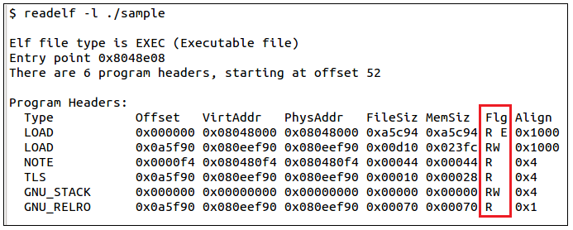
Protection mechanisms - W⊕X、DEP

Slide 9
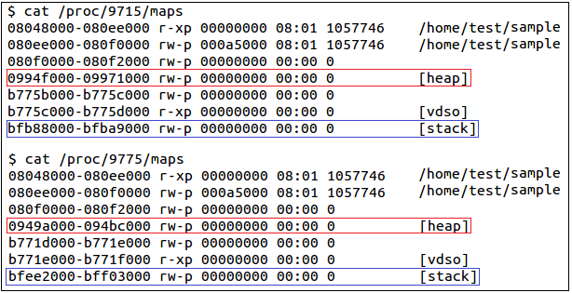
Protection mechanisms - ASLR

Slide 10
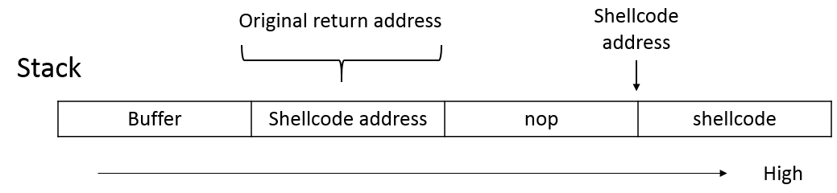
Exploit technique - Return-to-stack attack
Can’t bypass DEP & ASLR mechanisms.
Replace return address with shellcode address.

Slide 11
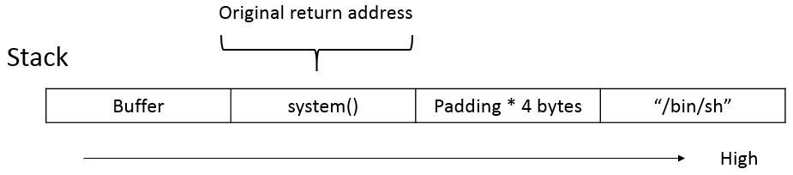
Exploit technique - Return-to-libc attack
Bypass W⊕X mechanisms.
Replace return address with other executable memory.

Slide 12

Return-Oriented Programming (ROP)
RET instruction sequences (gadgets)
Unrandomized segment
Notes:
Program logo building

Slide 13
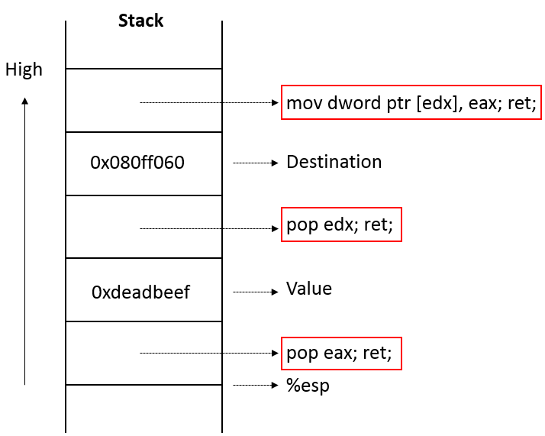

ROP Sample

Slide 14

More Complicated?

Slide 15
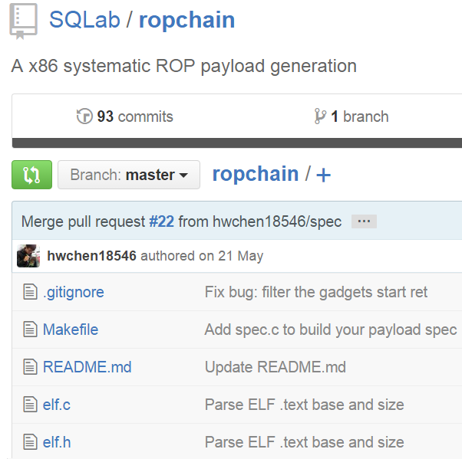
ROPChain
Generate multi payloads
Use long gadgets
Integrate with AEG、Metasploit
Notes:
ROPGadget

Slide 16
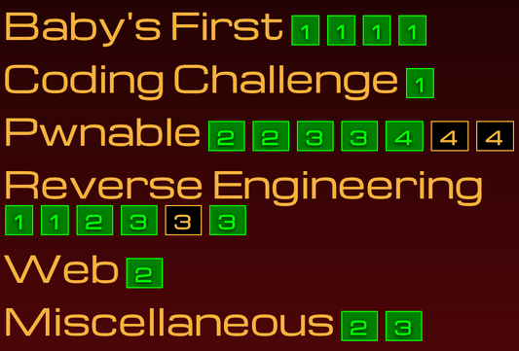
Defcon 2015 - fuckup
ELF 32-bit, static, NX
Re-randomize the text base
Notes:
ROPGadget

Slide 17
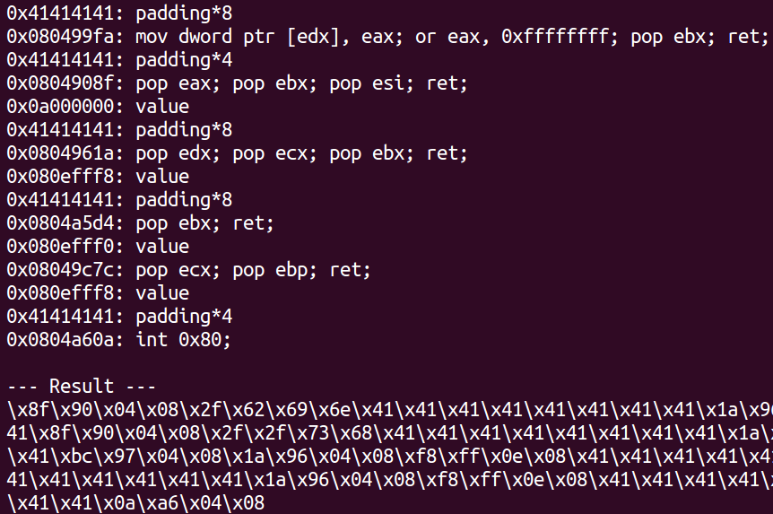
Defcon 2015 - fuckup
Notes:
ROPGadget

Slide 18
Exploit technique - Return-Oriented Programming
Derived from return-to-libc attack.
Chain instruction sequences, called gadgets.
Produce gadgets for performing Turing-complete operations.
Use the unrandomized code to bypass ASLR.

Slide 19
Exploit technique - Return-Oriented Programming

Slide 20
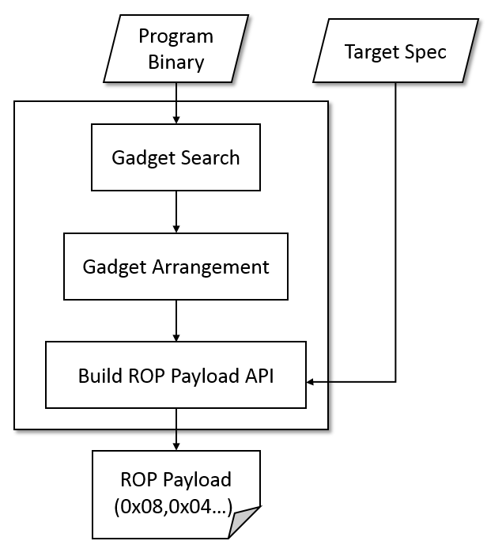
Method - Exploit Strengthening Method

Slide 21
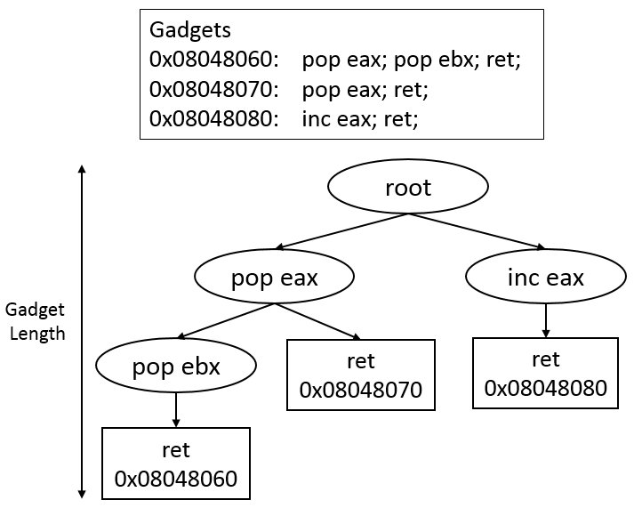
Method – Gadgets Search (1)
Use Capstone disassembly framework.
Build gadgets to a tree data structure.

Slide 22
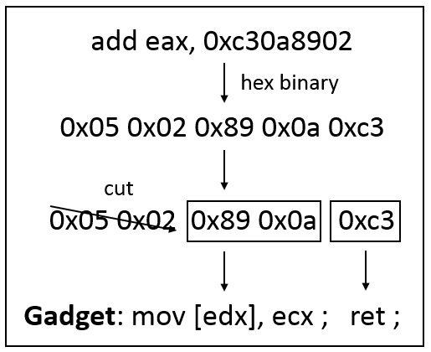
Method – Gadgets Search (2)
Get the instruction/gadget not belonging to the original program.

Slide 23
Method – Gadgets Arrangement (1)
libc gadgets not usable
Short gadgets v.s. Long gadgets
Inter-gadget v.s. Intra-gadget dependency problem

Slide 24
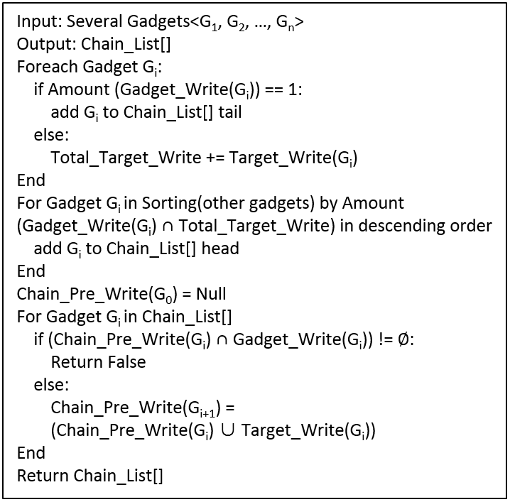
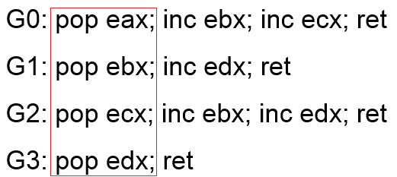
Method – Gadgets Arrangement (2)

Slide 25
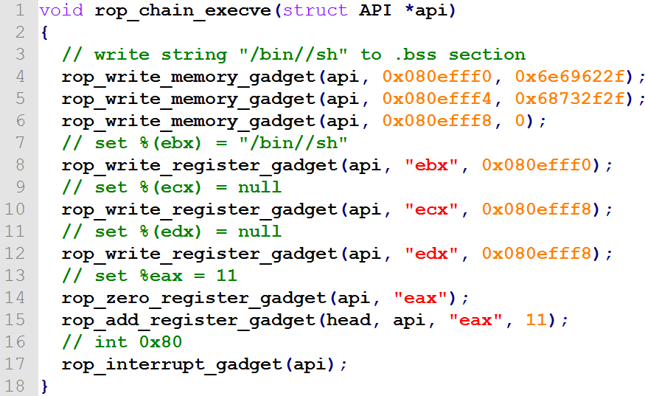
Implement – ROP Payload API
execve(“/bin/sh”)
eax = 0x11
ebx = address
point to “/bin/sh”
ecx = address
point to argv
edx = address
point to envp
int 0x80

Slide 26
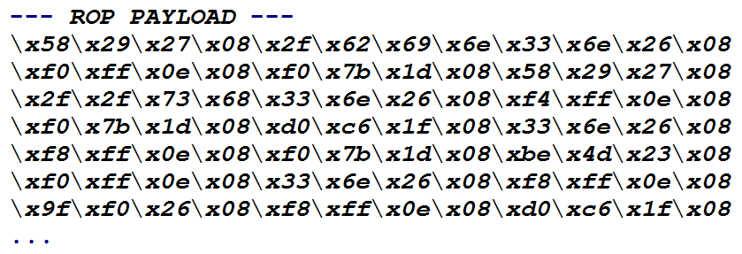
Implement – Generate ROP Payload

Slide 27
Implement – Turing Complete
Load/Store
Arithmetic and Logic
Control Flow
System Calls
Function Calls

Slide 28
Implement – Turing Complete
Load/Store
Loading a Constant to Register
Loading a Constant to Memory
Loading a Memory to Register
Alternative Gadgets

Slide 29
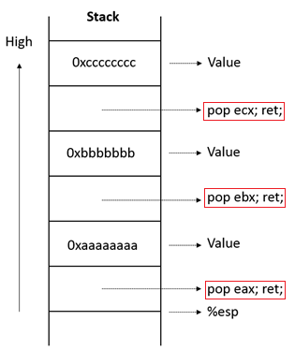
Implement – Loading a Constant to Register
int rop_write_register_gadget(
struct API *api,
char *dest,
unsigned int value)

Slide 30
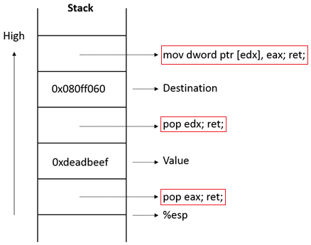
Implement – Loading a Constant to Memory
int rop_write_memory_gadget(
struct API *api,
unsigned int dest,
unsigned int value)

Slide 31
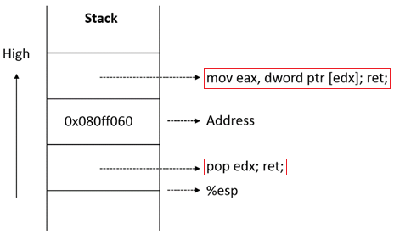
Implement – Loading a Memory to Register
int rop_read_memory_gadget(
struct API *api,
char *dest,
unsigned int src)

Slide 32
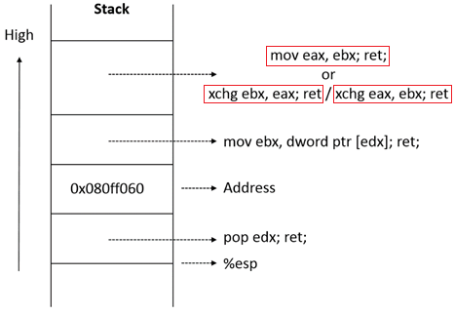
Implement – Alternative Gadgets
int rop_move_register_gadget(
struct API *api,
char *dest,
char *src)

Slide 33
Implement – Arithmetic and Logic
Arithmetic and Logic
Setting zero to Register
Add/Sub a Constant
Shift
…

Slide 34
Implement – Control Flow
Control Flow
Unconditional Jump
Conditional Jump

Slide 35
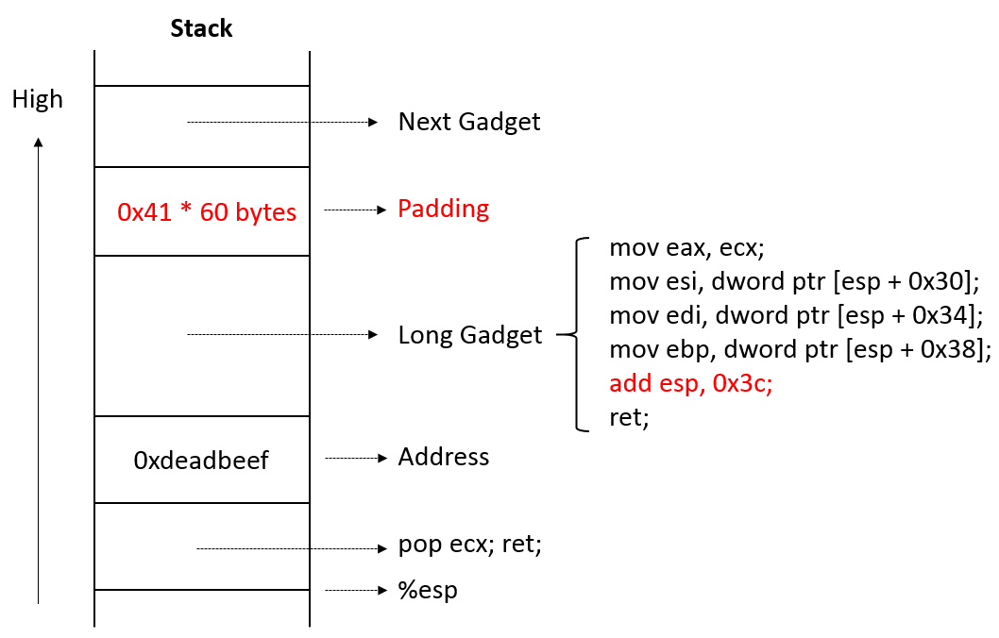
Implement – Unconditional Jump
Arithmetic esp register
Long gadget side effect

Slide 36
Implement – Conditional Jump
Compare and trigger the special flag
Save the flag result (0 or 1) to memory
Convert the flag result (0 or 1) to jump info (0 or delta)
Add esp register value (0 or delta)

Slide 37
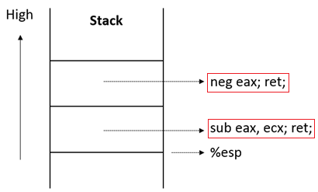
Implement – Conditional Jump (1)
Compare and trigger the special flag

Slide 38
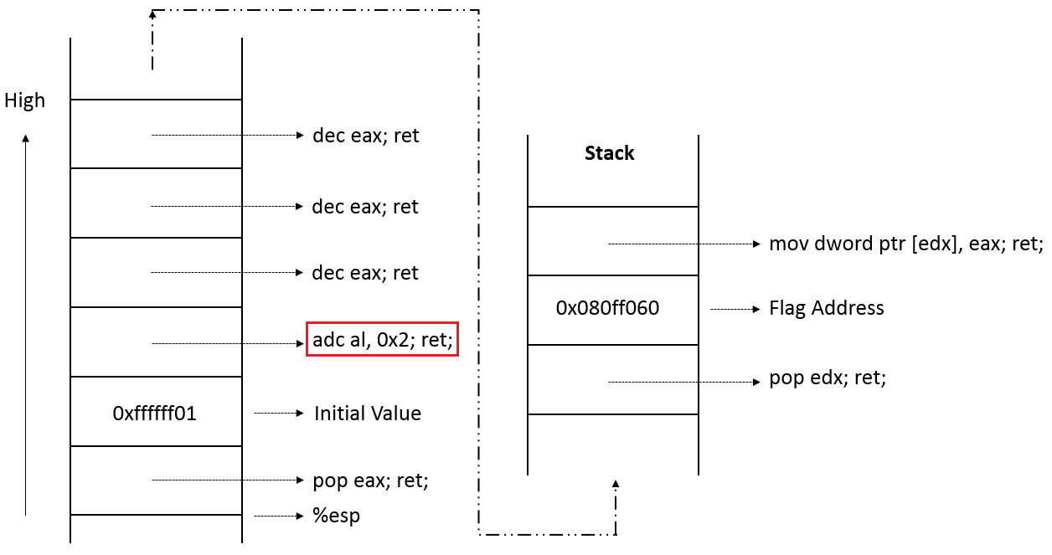
Implement – Conditional Jump (2)
Save the flag result (0 or 1) to memory

Slide 39
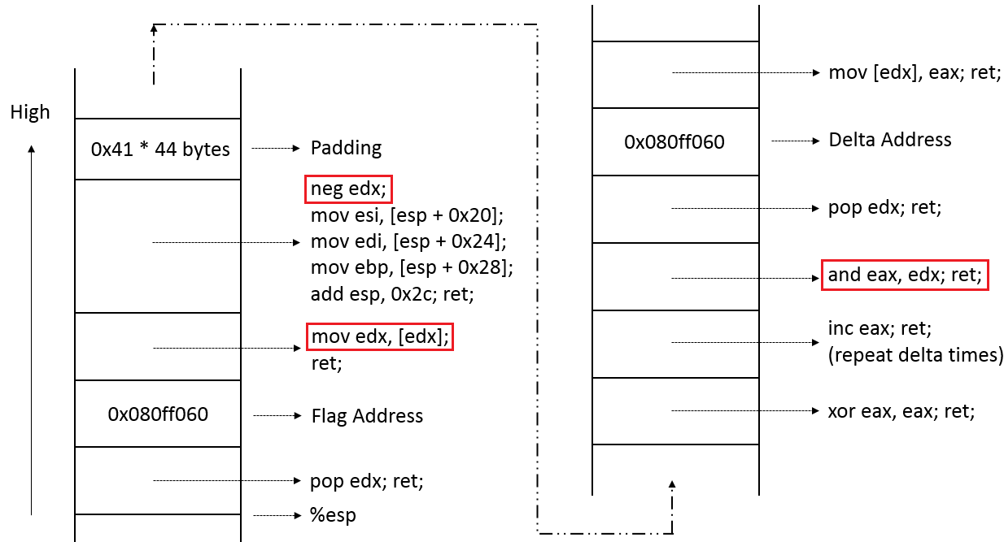
Implement – Conditional Jump (3)
Convert the flag result (0 or 1) to jump info (0 or delta)

Slide 40
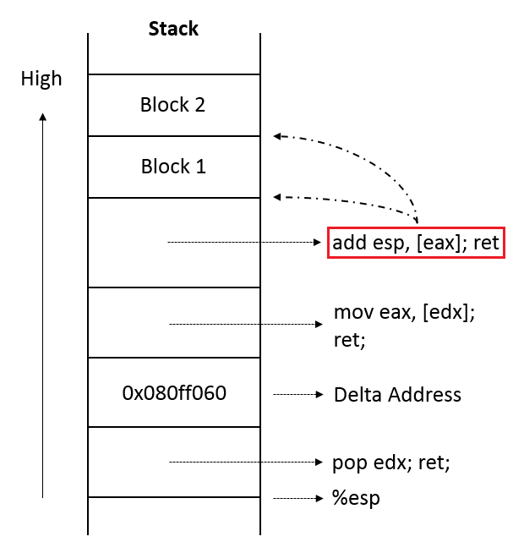
Implement – Conditional Jump (3)
Add esp register value (0 or delta)

Slide 41
Integration
Automatic Exploit Generation (CRAX)
Post Exploitation Framework (Metasploit)

Slide 42
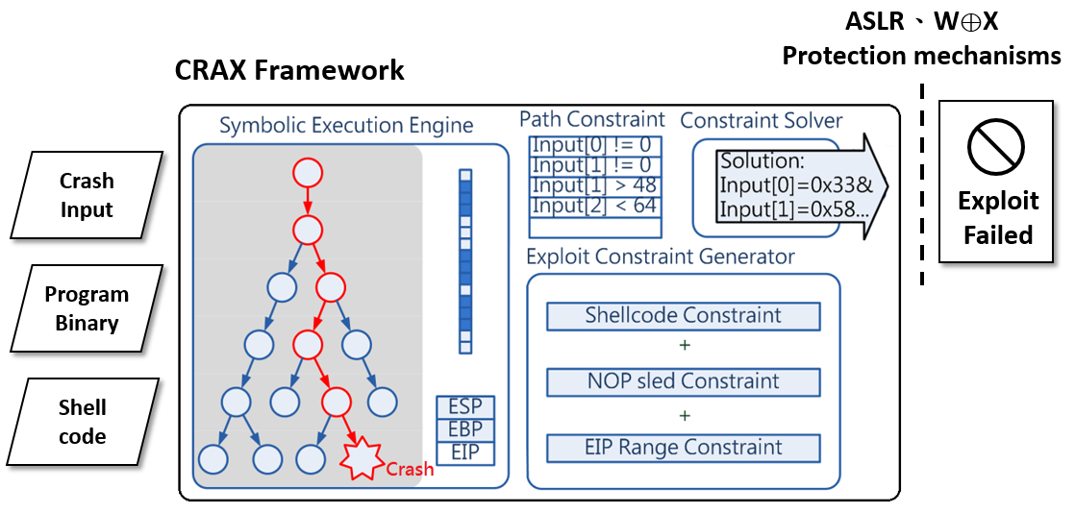
Integration - CRAX

Slide 43
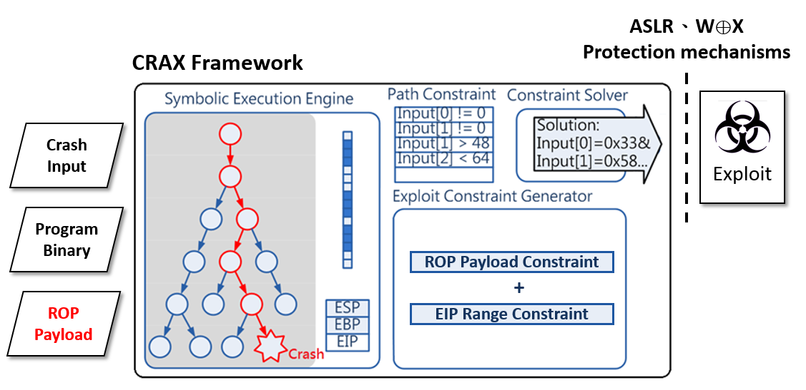
Integration - CRAX with ROP

Slide 44
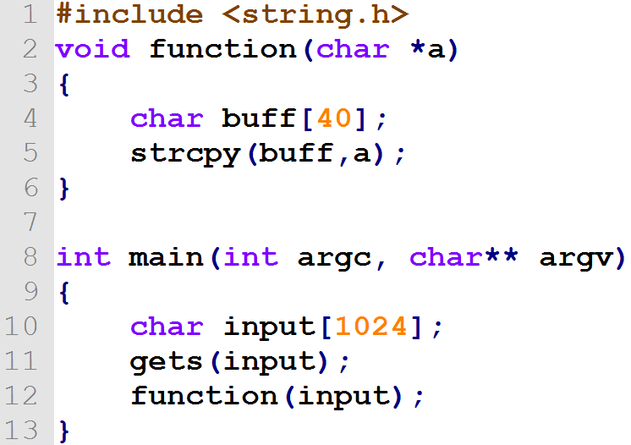
Integration – Metasploit (1)
Target machine (192.168.184.133) with a vulnerable program.

Slide 45
Integration – Metasploit (2)
Use exploit strengthening method generate a customized Reverse TCP shell payload. (192.168.184.134:4000)

Slide 46
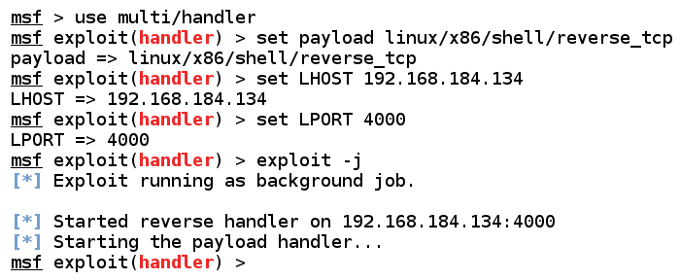
Integration – Metasploit (3)
Attacker set Metasploit handler

Slide 47
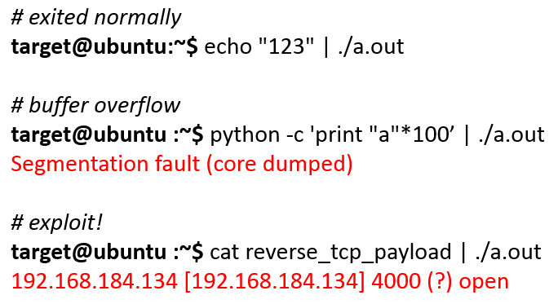
Integration – Metasploit (4)
Target machine (192.168.184.133) run the program with ROP payload

Slide 48
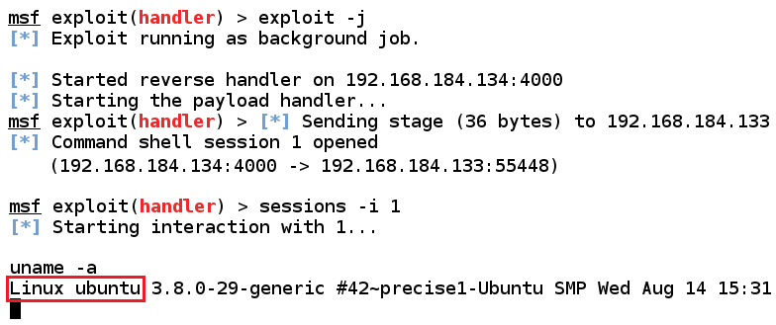
Integration – Metasploit (5)
Take control of target machine.

Slide 49
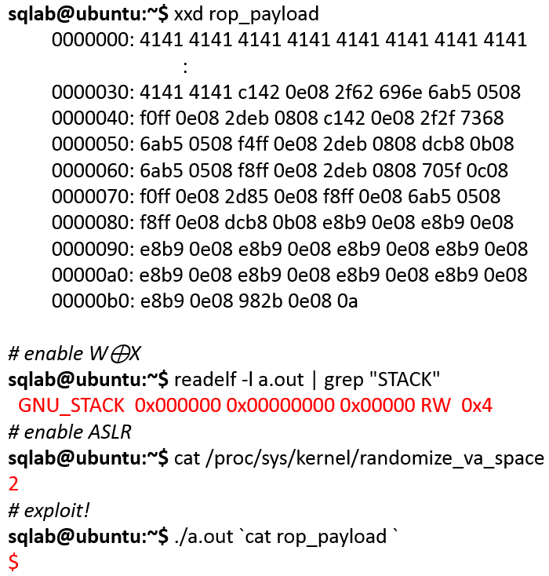
Result – Bypass W⊕X and ASLR

Slide 50
Result – Compare with ROPgadget
ROPgadget: Common open source search and chain gadgets tool
Tool Compare | Exploit Strengthening | ROPgadget
Gadget Type | Long/Short Gadgets | Short Gadgets
Payload Type | Turing complete ROP Payload API | One type payload
Integrate | CRAX + Metasploit

Slide 51
Result – Compare with ROPgadget
Program Name | Program Size | Exploit Strengthening |  |  | ROPgadget
 |  | Total Gadgets | Time | Generate Payload | Time | Generate Payload
gdb 7.7.1 | 4.9M | 133K | 36.2s | True | 278s | True
nautilus 3.10.1 | 1.4M | 58K | 13.9s | True | -- | False
gpg 1.4.16 | 971K | 25K | 5.5s | True | 17.1s | True
vim.tiny 7.4 | 806K | 25K | 5.0s | True | -- | False
lshw b.02.16 | 755K | 8K | 2.4s | True | -- | False
gcc 4.8 | 700K | 4K | 2.9s | True | 10.7s | True
objdump 2.24 | 333K | 8K | 1.4s | True | -- | False
readom 1.1.11 | 180K | 4.9K | 0.9s | True | -- | False
curl 7.35.0 | 149K | 2.9K | 0.7s | True | -- | False
factor 8.21 | 104K | 2.3K | 0.5s | True | -- | False
Payload type: exevc(“/bin/sh”)

Slide 52
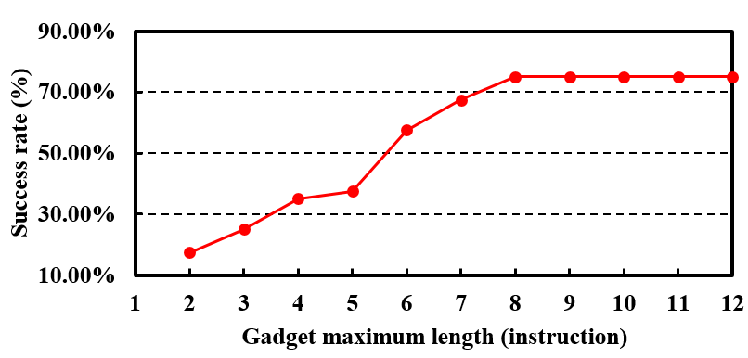
Result – Why Exploit Strengthening Method Better?
Forty programs in /usr/bin, size between 100KB and 5MB.

Slide 53
Conclusion – Exploit Toolchain
Exploit Strengthening:
Truing complete ROP Payload API
Generate bypassing W⊕X and ASLR payload
Automatic Exploit Generation:
Convert crash to anti-mitigation exploit
Post Exploitation Framework:
Integrate Metasploit
Make Post-exploit easier

Slide 54
Further Work
Improve gadget utilization like arithmetic memory gadgets.
Add fuzzer to exploit toolchain.

